Slide 1
面向目标探测的脑机融合技术与应用
Brain-inspired EEG-based Video Target Detection
Brain-Inspired Deep Learning Model for EEG-Based Low-Quality Video Target Detection with Phased Encoding and Aligned Fusion
Dehao Wang¹, Jianting Shi², Manyu Liu², Wenao Han², Luzheng Bi² ,Weijie Fei^{2*}
¹School of Integrated Circuits and Electronics, Beijing Institute of Technology
²School of Mechanical Engineering, Beijing Institute of Technology
Accepted by Expert Systems with Applications

Slide 2
面向目标探测的脑机融合技术与应用
Brain-inspired EEG-based Video Target Detection
Introduction
Method
Experiments
Results and Discussion

Slide 3
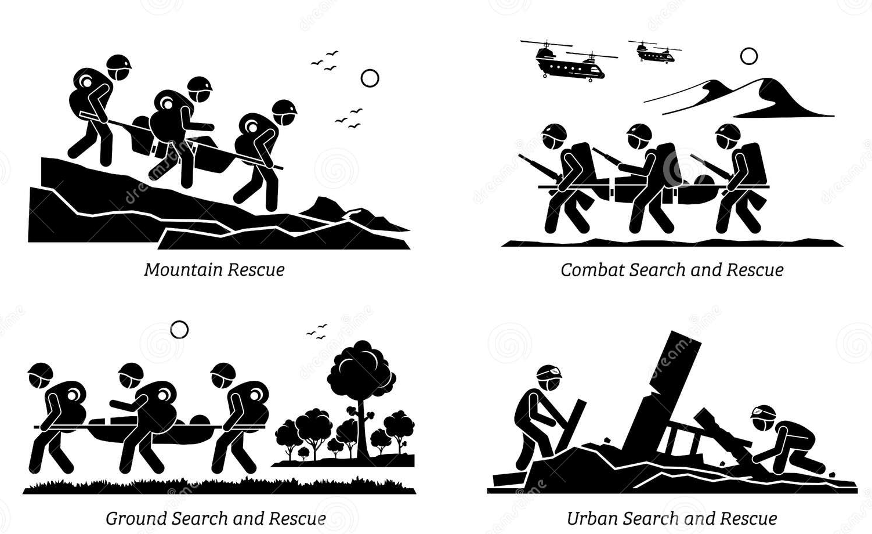
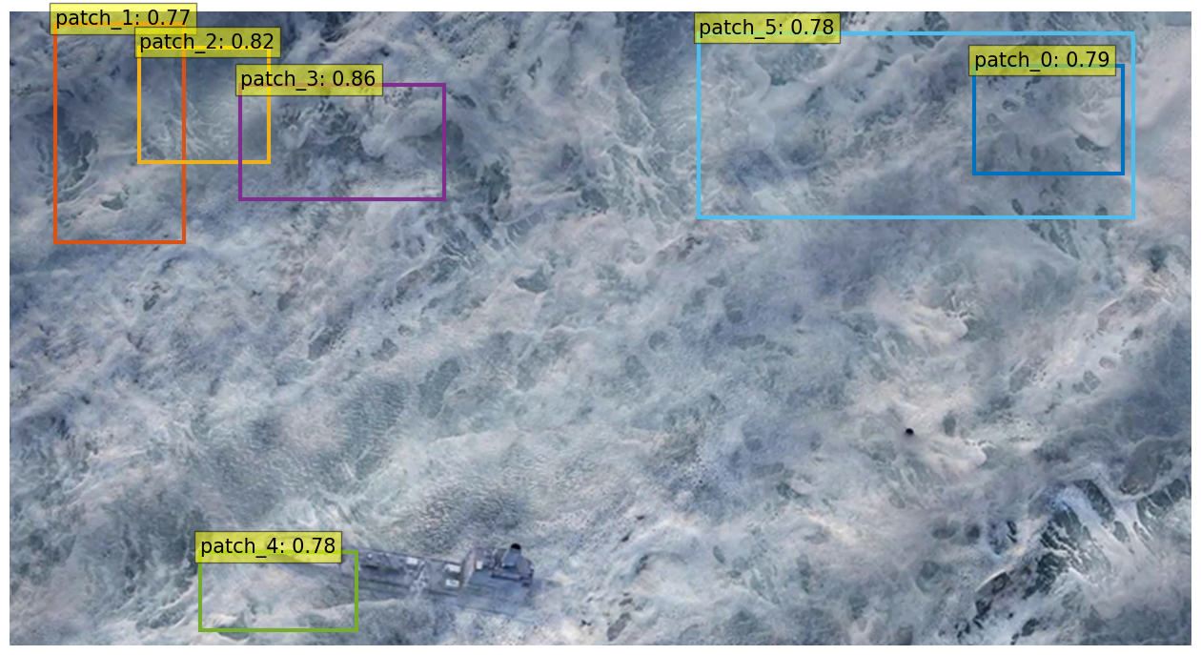
面向目标探测的脑机融合技术与应用
Brain-inspired EEG-based Video Target Detection
1. Introduction
⚠️ Traditional CV methods for low-quality video target detection
Viewpoint and Quality Constraints: Different perspectives, occluded, fragmented, or small targets
Lack of Prior Knowledge and Samples: Scenarios like military or disaster response have few-shot problem
False alarm
Miss target
The results are from the unsupervised object detection model Up-DETR.
Expert Systems with Applications
Brain-Inspired Deep Learning Model for EEG-Based Low-Quality Video Target Detection with Phased Encoding and Aligned Fusion
D Wang et al.

Slide 4
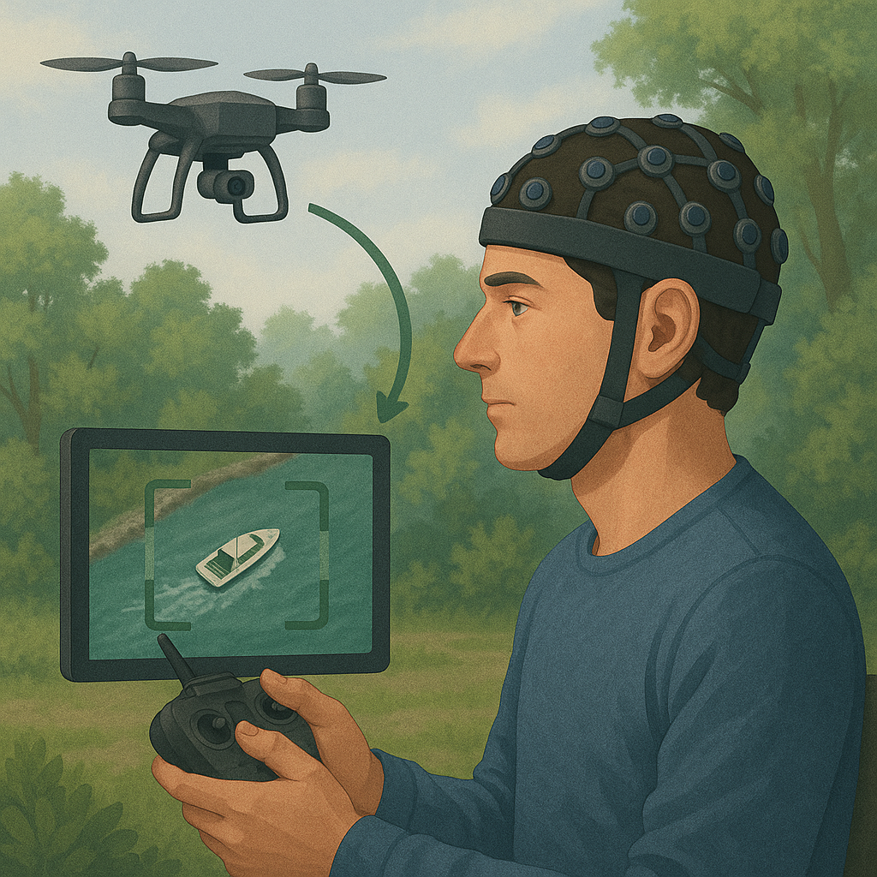
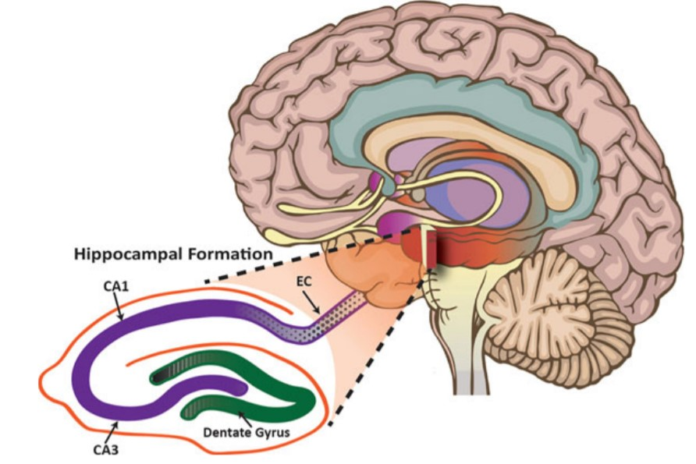
面向目标探测的脑机融合技术与应用
Brain-inspired EEG-based Video Target Detection
1. Introduction
🧠Human brain strengths:
🚀Why BCI is needed:
Real-time Application
Multitasking environments
Strong Contextual Inference
Few-Shot Generalization
Expert Systems with Applications
Brain-Inspired Deep Learning Model for EEG-Based Low-Quality Video Target Detection with Phased Encoding and Aligned Fusion
D Wang et al.

Slide 5
面向目标探测的脑机融合技术与应用
Brain-inspired EEG-based Video Target Detection
1. Introduction
Existed learning method for EEG decoding:
Time-series: GRU, LSTM…
Convolution: EEGNet, DeepConvNet, EEG-Inception…
Transformer: TFF-Former…
Graph: STGCN…
Can we get more insight from brain science?
Expert Systems with Applications
Brain-Inspired Deep Learning Model for EEG-Based Low-Quality Video Target Detection with Phased Encoding and Aligned Fusion
D Wang et al.

Slide 6
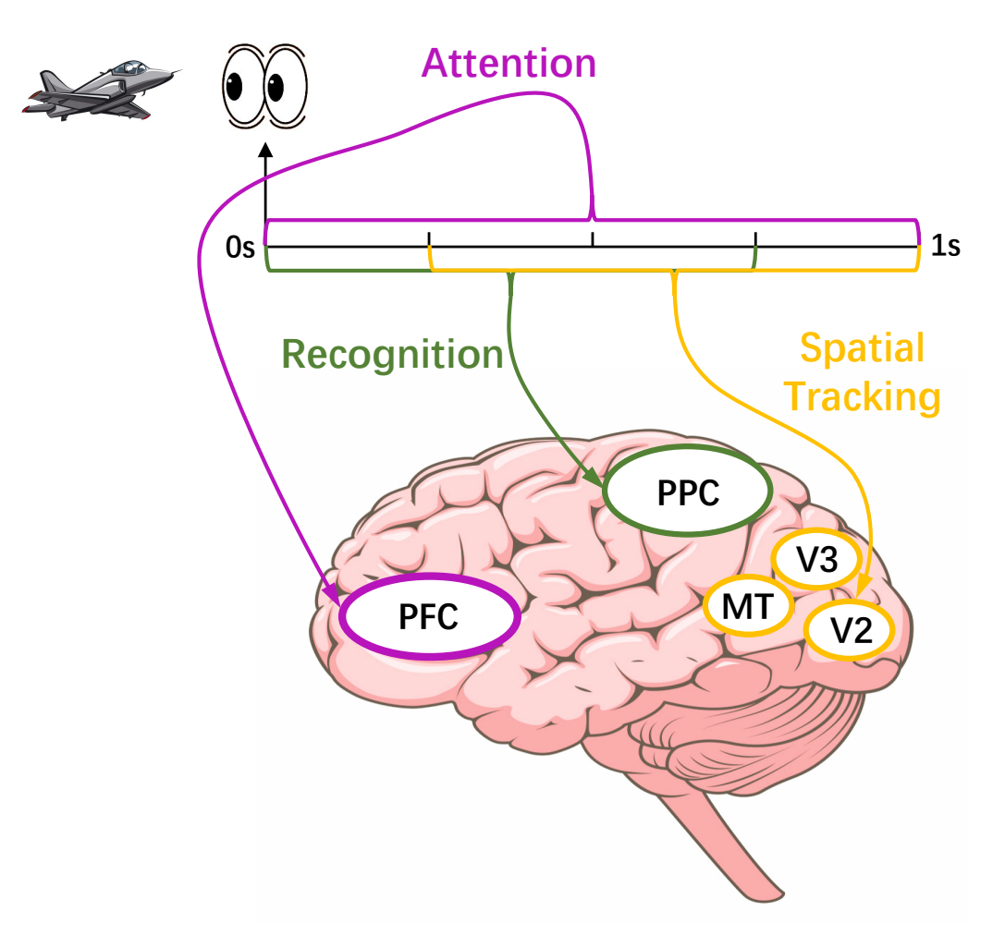
面向目标探测的脑机融合技术与应用
Brain-inspired EEG-based Video Target Detection
1. Introduction
🔍Our findings in this BCI paradigm:
The brain's response to detecting targets in the video is phase-based!
🤔How can this inspire and inform our model design?
Expert Systems with Applications
Brain-Inspired Deep Learning Model for EEG-Based Low-Quality Video Target Detection with Phased Encoding and Aligned Fusion
D Wang et al.

Slide 7
面向目标探测的脑机融合技术与应用
Brain-inspired EEG-based Video Target Detection
2. Method
Overall Architecture
Expert Systems with Applications
Brain-Inspired Deep Learning Model for EEG-Based Low-Quality Video Target Detection with Phased Encoding and Aligned Fusion
D Wang et al.

Slide 8
面向目标探测的脑机融合技术与应用
Brain-inspired EEG-based Video Target Detection
2. Method
Phased Encoder
Expert Systems with Applications
Brain-Inspired Deep Learning Model for EEG-Based Low-Quality Video Target Detection with Phased Encoding and Aligned Fusion
D Wang et al.

Slide 9
面向目标探测的脑机融合技术与应用
Brain-inspired EEG-based Video Target Detection
2. Method
Overall Architecture
Expert Systems with Applications
Brain-Inspired Deep Learning Model for EEG-Based Low-Quality Video Target Detection with Phased Encoding and Aligned Fusion
D Wang et al.

Slide 10
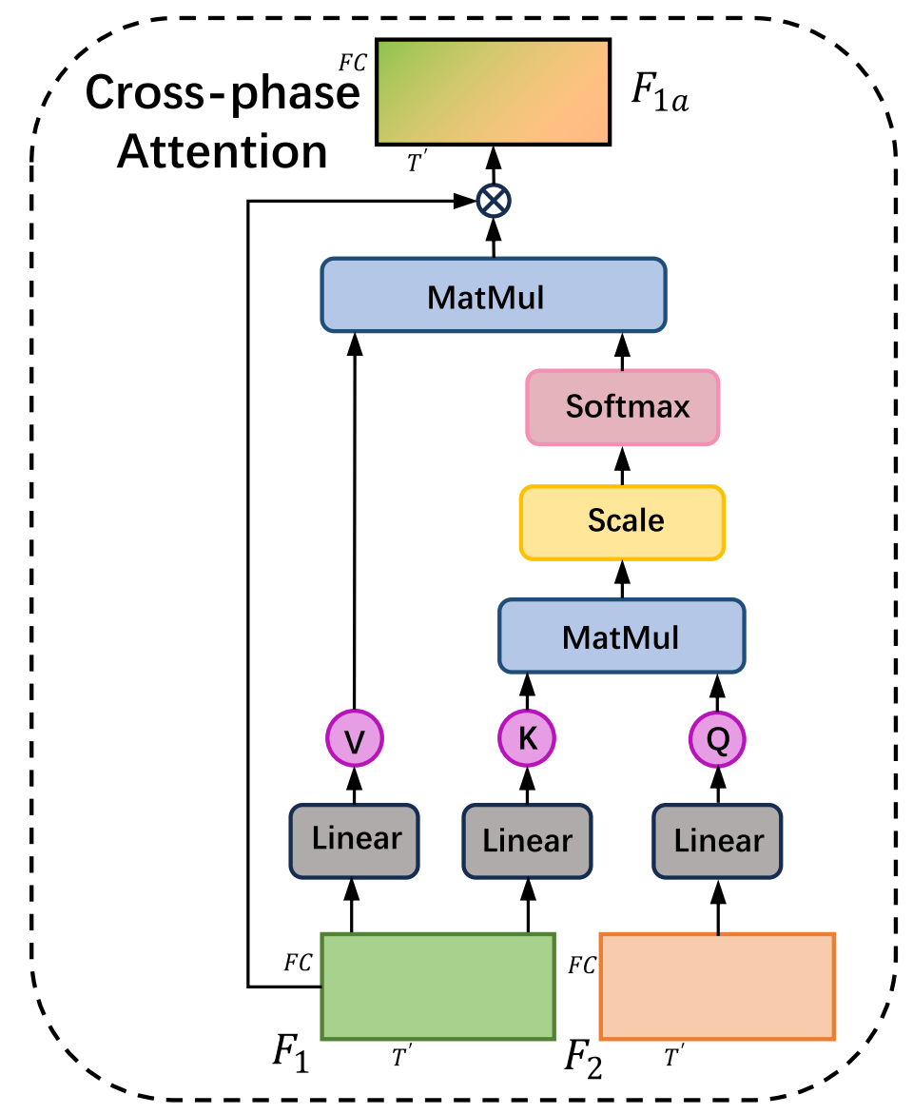
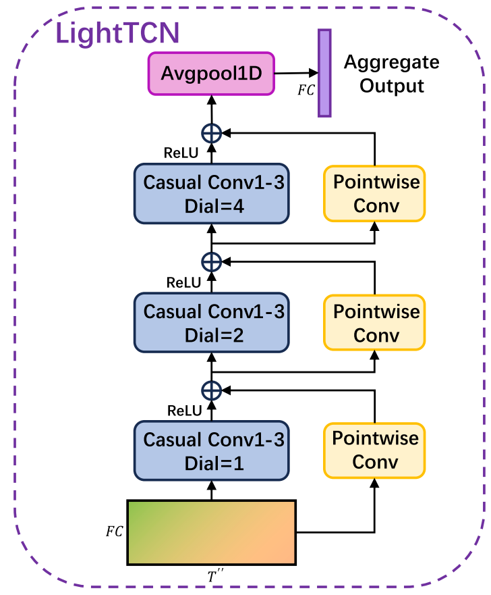
面向目标探测的脑机融合技术与应用
Brain-inspired EEG-based Video Target Detection
2. Method
Other Key Components
Expert Systems with Applications
Brain-Inspired Deep Learning Model for EEG-Based Low-Quality Video Target Detection with Phased Encoding and Aligned Fusion
D Wang et al.

Slide 11
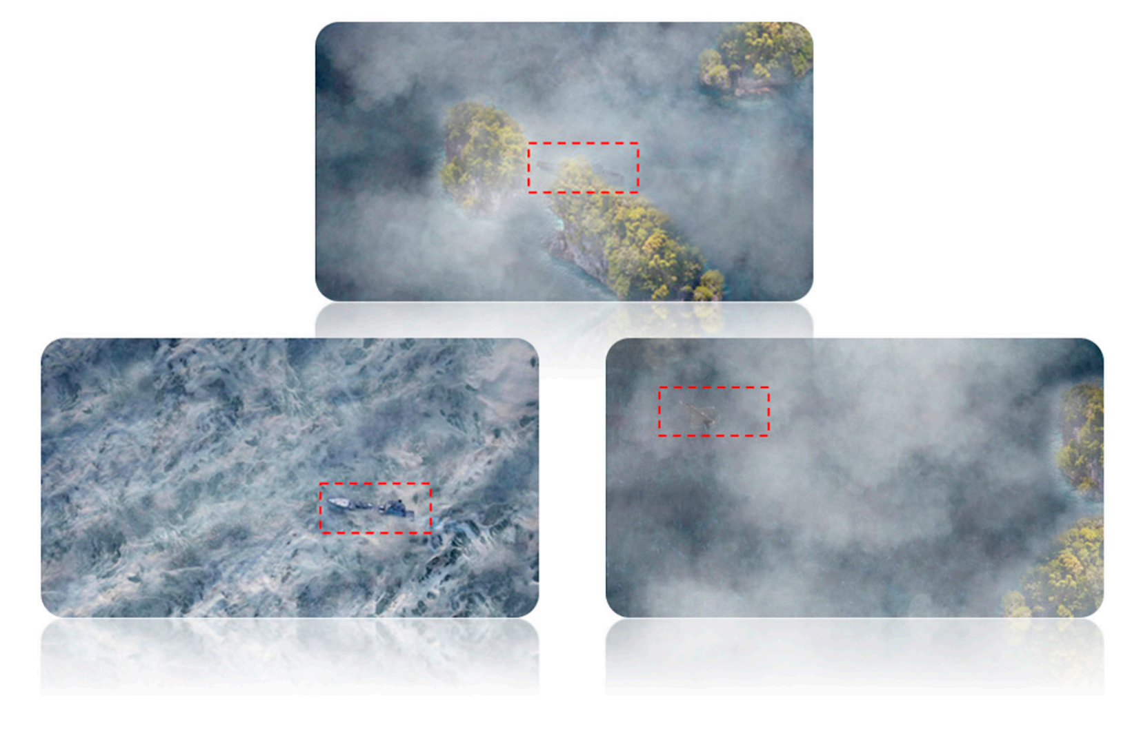
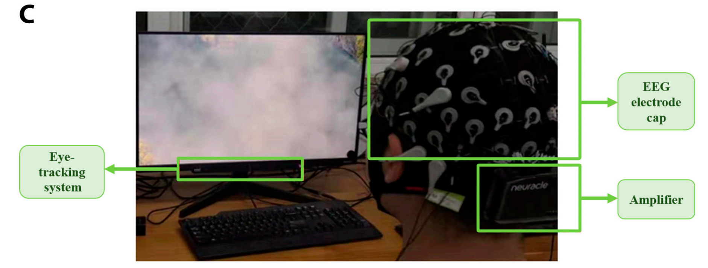
面向目标探测的脑机融合技术与应用
Brain-inspired EEG-based Video Target Detection
3. Experiments
Video stimuli:
Equipments:
Expert Systems with Applications
Brain-Inspired Deep Learning Model for EEG-Based Low-Quality Video Target Detection with Phased Encoding and Aligned Fusion
D Wang et al.

Slide 12
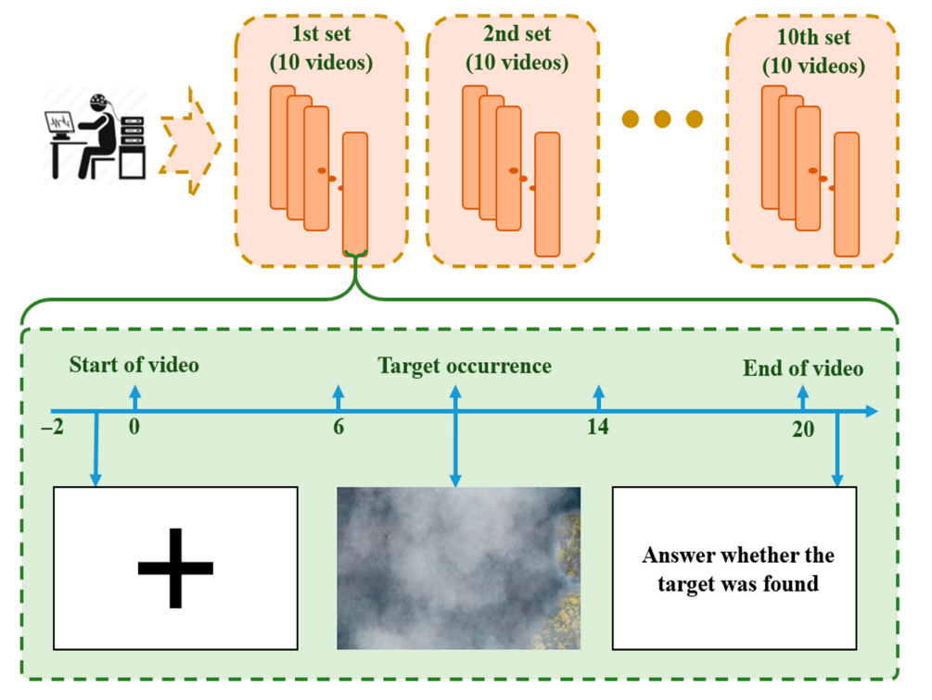
面向目标探测的脑机融合技术与应用
Brain-inspired EEG-based Video Target Detection
3. Experiments
Experiment paradigm 1
8 subjects: 6-1-1 cross validation
Expert Systems with Applications
Brain-Inspired Deep Learning Model for EEG-Based Low-Quality Video Target Detection with Phased Encoding and Aligned Fusion
D Wang et al.

Slide 13
面向目标探测的脑机融合技术与应用
Brain-inspired EEG-based Video Target Detection
3. Experiments
Experiment paradigm 2 (cognitive distraction)
2 subjects: indivisual validation
Cognitive distraction task
N-back (N=1)
8
2
6
5
9
Expert Systems with Applications
Brain-Inspired Deep Learning Model for EEG-Based Low-Quality Video Target Detection with Phased Encoding and Aligned Fusion
D Wang et al.

Slide 14
面向目标探测的脑机融合技术与应用
Brain-inspired EEG-based Video Target Detection
3. Experiments
🔄Data process pipeline
1. Eye movement alignment
2. Baseline correction
3. Band-pass filter (0.5-49Hz)
4. Downsampling
(1000Hz to 200Hz)
5. ICA to reduce artifacts
(optional: two datasets)
Expert Systems with Applications
Brain-Inspired Deep Learning Model for EEG-Based Low-Quality Video Target Detection with Phased Encoding and Aligned Fusion
D Wang et al.

Slide 15
面向目标探测的脑机融合技术与应用
Brain-inspired EEG-based Video Target Detection
4. Results and Discussion
Time-domain evidence of the brain's phased responses
by Fixation-Related Potentials (FRP) analysis
PPC
MT, V2, V3
PFC
Expert Systems with Applications
Brain-Inspired Deep Learning Model for EEG-Based Low-Quality Video Target Detection with Phased Encoding and Aligned Fusion
D Wang et al.

Slide 16
面向目标探测的脑机融合技术与应用
Brain-inspired EEG-based Video Target Detection
4. Results and Discussion
Frequency-domain evidence of the brain's phased responses
by Fixation-Related Spectral Perturbation (FRSP) analysis
PPC
MT, V2, V3
PFC
Expert Systems with Applications
Brain-Inspired Deep Learning Model for EEG-Based Low-Quality Video Target Detection with Phased Encoding and Aligned Fusion
D Wang et al.

Slide 17
面向目标探测的脑机融合技术与应用
Brain-inspired EEG-based Video Target Detection
4. Results and Discussion
t-SNE visualization of model features in different stages
separate encoding
alignment
fusion
Expert Systems with Applications
Brain-Inspired Deep Learning Model for EEG-Based Low-Quality Video Target Detection with Phased Encoding and Aligned Fusion
D Wang et al.

Slide 18
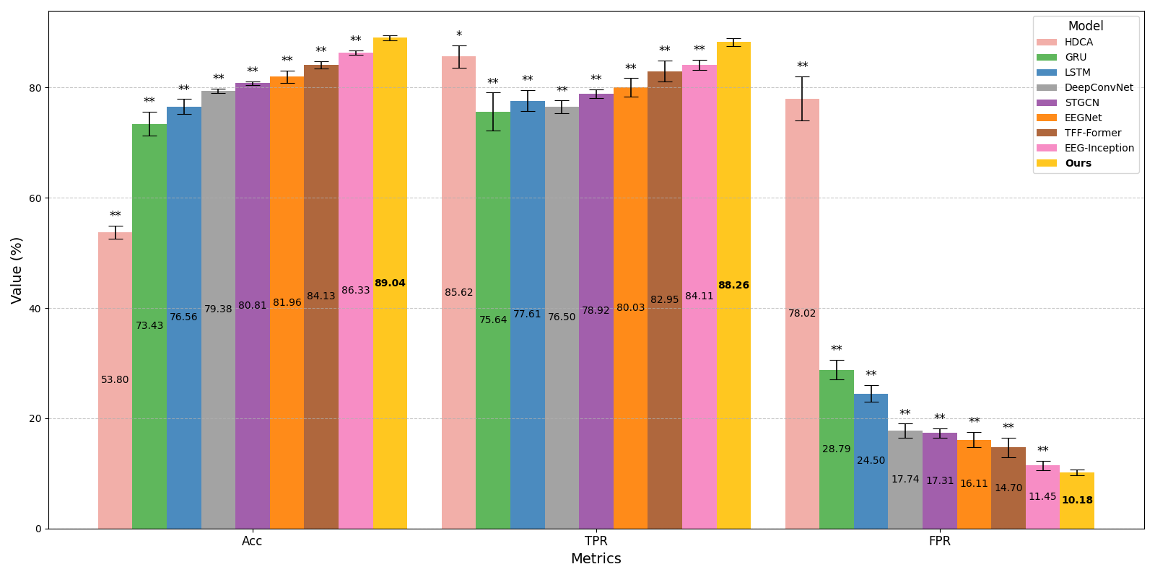
面向目标探测的脑机融合技术与应用
Brain-inspired EEG-based Video Target Detection
4. Results and Discussion
Comparison results with the baseline model (with ICA)
Expert Systems with Applications
Brain-Inspired Deep Learning Model for EEG-Based Low-Quality Video Target Detection with Phased Encoding and Aligned Fusion
D Wang et al.

Slide 19
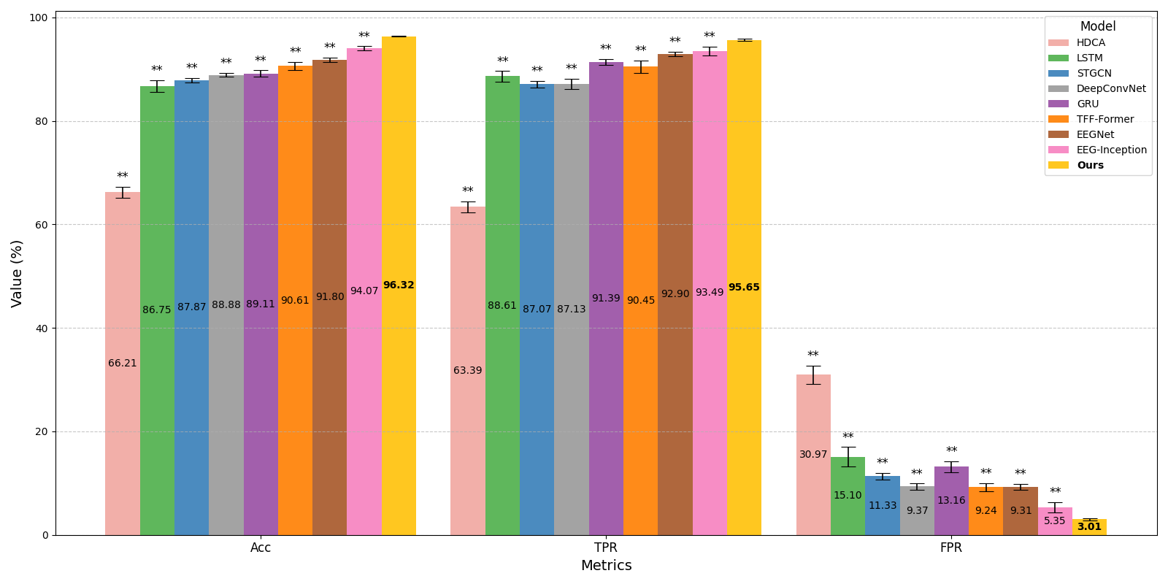
面向目标探测的脑机融合技术与应用
Brain-inspired EEG-based Video Target Detection
4. Results and Discussion
Comparison results with the baseline model (without ICA)
Expert Systems with Applications
Brain-Inspired Deep Learning Model for EEG-Based Low-Quality Video Target Detection with Phased Encoding and Aligned Fusion
D Wang et al.

Slide 20
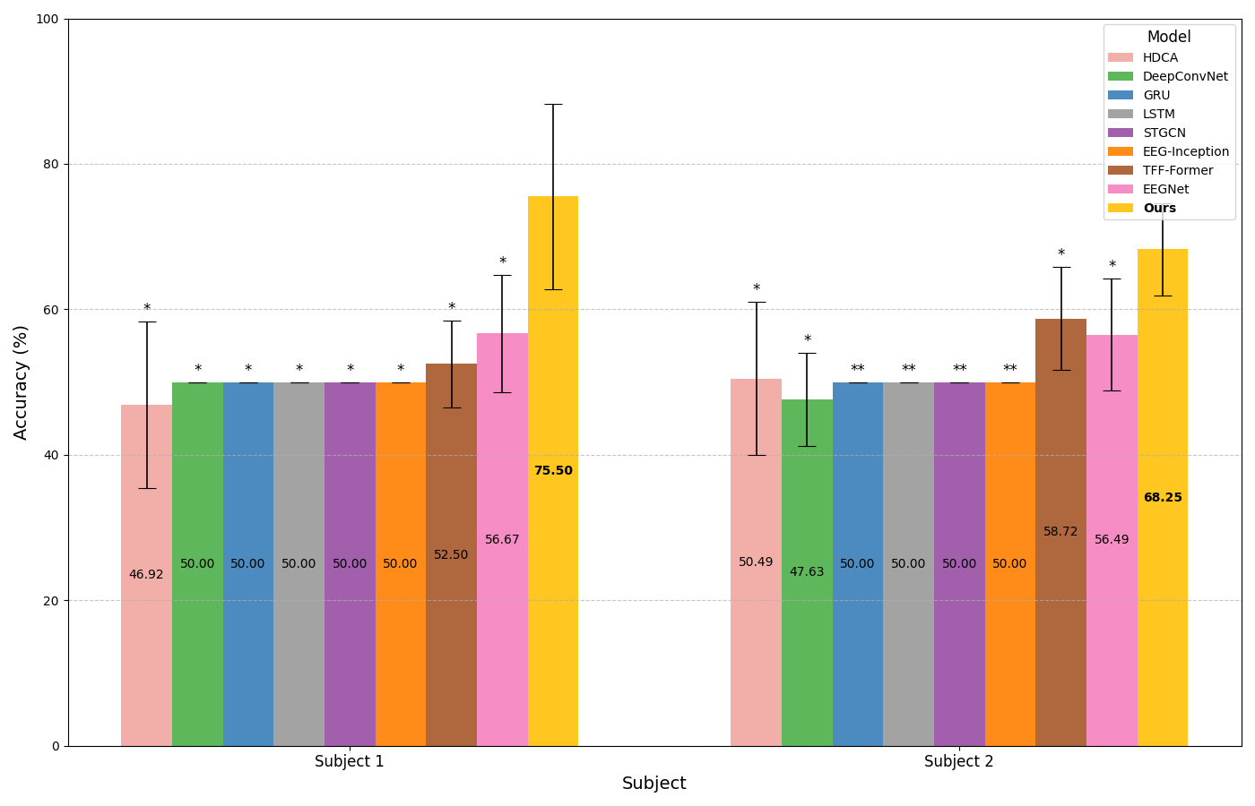
面向目标探测的脑机融合技术与应用
Brain-inspired EEG-based Video Target Detection
4. Results and Discussion
Comparison results with the baseline model (cognitive distraction)
Expert Systems with Applications
Brain-Inspired Deep Learning Model for EEG-Based Low-Quality Video Target Detection with Phased Encoding and Aligned Fusion
D Wang et al.

Slide 21
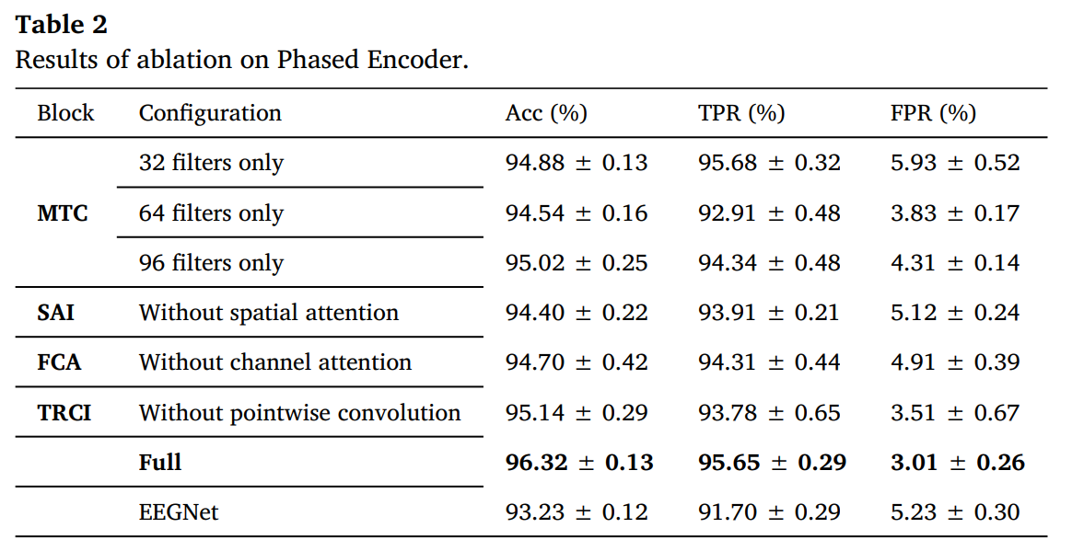
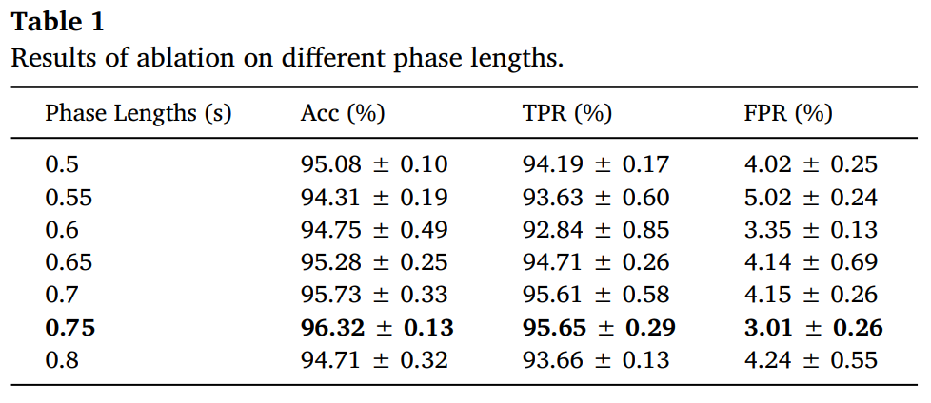
面向目标探测的脑机融合技术与应用
Brain-inspired EEG-based Video Target Detection
4. Results and Discussion
Ablation Study
Expert Systems with Applications
Brain-Inspired Deep Learning Model for EEG-Based Low-Quality Video Target Detection with Phased Encoding and Aligned Fusion
D Wang et al.

Slide 22
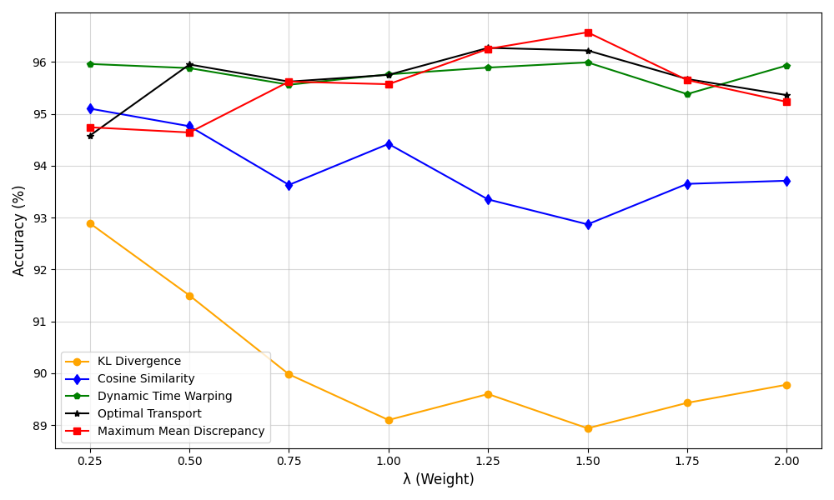
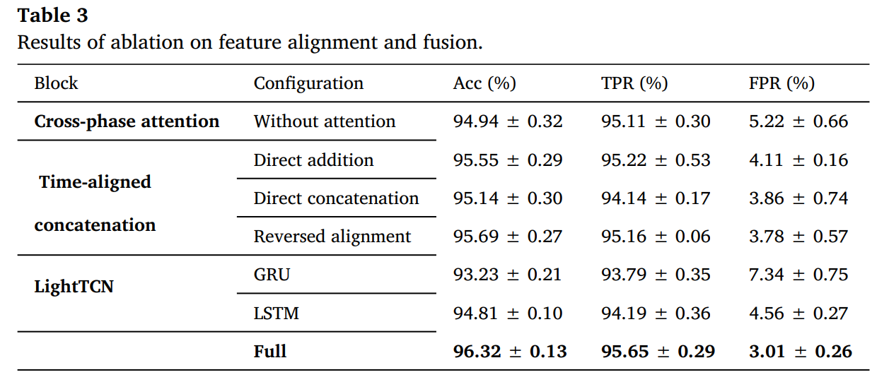
面向目标探测的脑机融合技术与应用
Brain-inspired EEG-based Video Target Detection
4. Results and Discussion
Ablation Study
Different alignment loss
Expert Systems with Applications
Brain-Inspired Deep Learning Model for EEG-Based Low-Quality Video Target Detection with Phased Encoding and Aligned Fusion
D Wang et al.

Slide 23
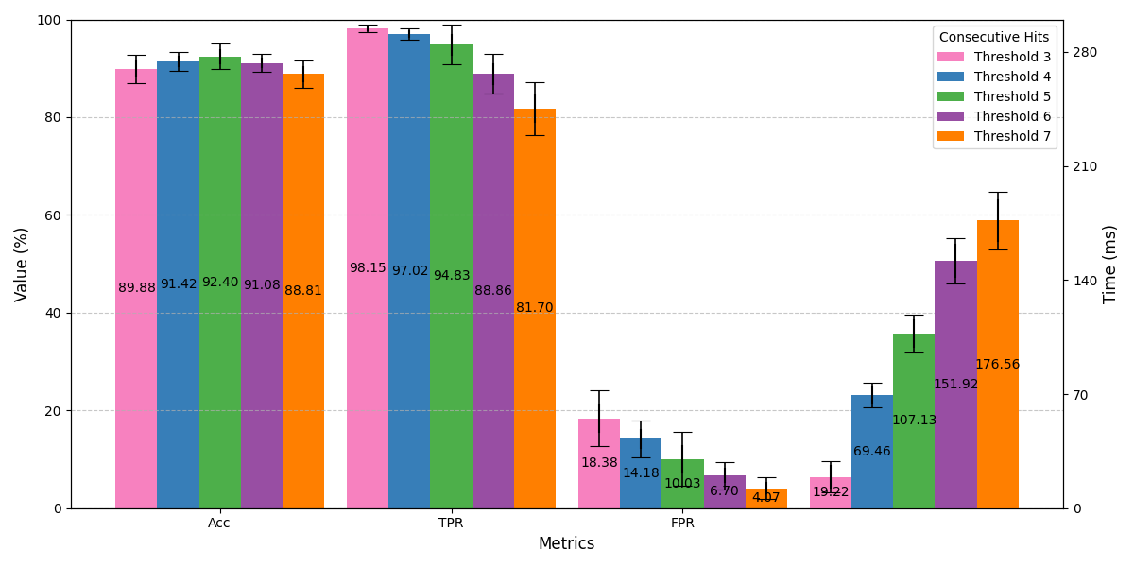
面向目标探测的脑机融合技术与应用
Brain-inspired EEG-based Video Target Detection
4. Results and Discussion
Pseudo-online test
(consecutive hit strategy)
Expert Systems with Applications
Brain-Inspired Deep Learning Model for EEG-Based Low-Quality Video Target Detection with Phased Encoding and Aligned Fusion
D Wang et al.

Slide 24
Thanks!
Deep Learning Model for EEG-Based Low-Quality Video Target Detection with Phased Encoding and Aligned Fusion
Dehao Wang, Jianting Shi, Manyu Liu, Wenao Han, Luzheng Bi, Weijie Fei.
https://github.com/Wonder-How/PSAFNet
Thanks!

